Slide 1

Facial Login App & Emotion Detection
CS2310 Multimedia Software Engineering
Project – Final Presentation
12/7/2017
Injung Kim

Slide 2
Facial Login App

Slide 3
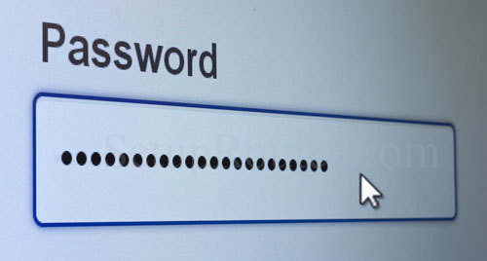
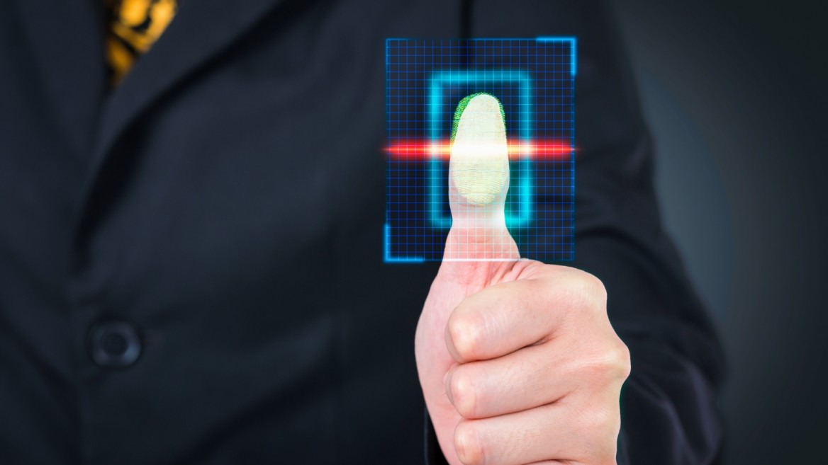
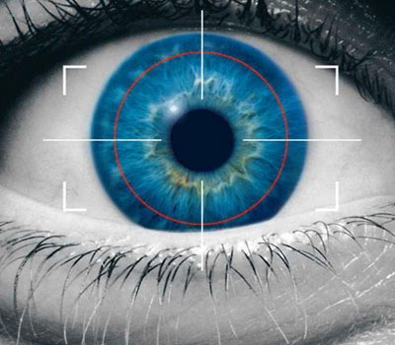
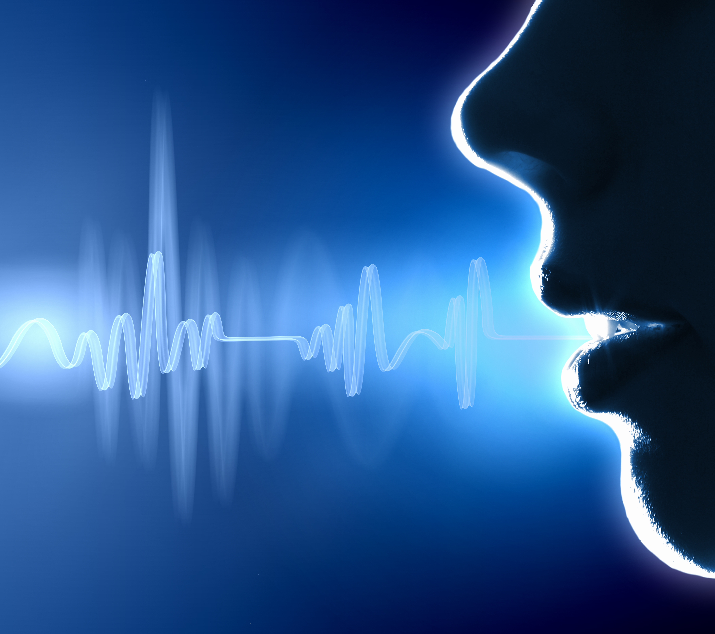
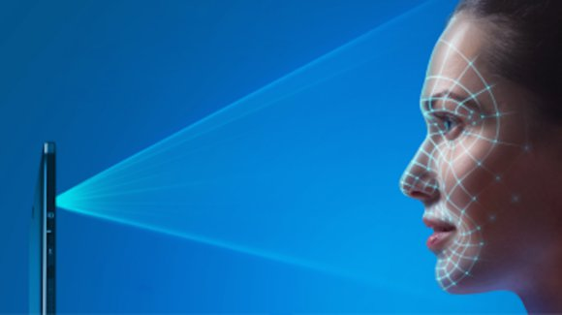
Time to say goodbye, Password
Goodbye, Password
Notes:
Password:
Hard to remember
Easy to crack
Breaches occur
Why Biometric?
identity theft is not possible
pwd remembrance problem doesn’t exist
can’t be predicted or hacked
can’t be shared
Fingerprint
need two-factor authentication
dirt, dryness, injury
Iris scanning
requires an Infrared (IR) camera which isn’t on many phones
poor lighting
Voice
noise
Face
hair, classes, age

Slide 4

Why Intelligent Facial Login?
Better than passwords
Flexible
Easy
No needs to remember
No secret is stored on servers
Identity theft is not possible
Can’t be predicted or hacked
Can’t be shared
Integrate using the language and
platform of your choice
Breadth of offerings to find the right
API for you
No dependency of camera type
or device
Ex) IRIS needs Infrared Camera
iPhone X Face login works on
only their device
No worry for noise or new device
No need to understand AI:
face detection or recognition

Slide 5
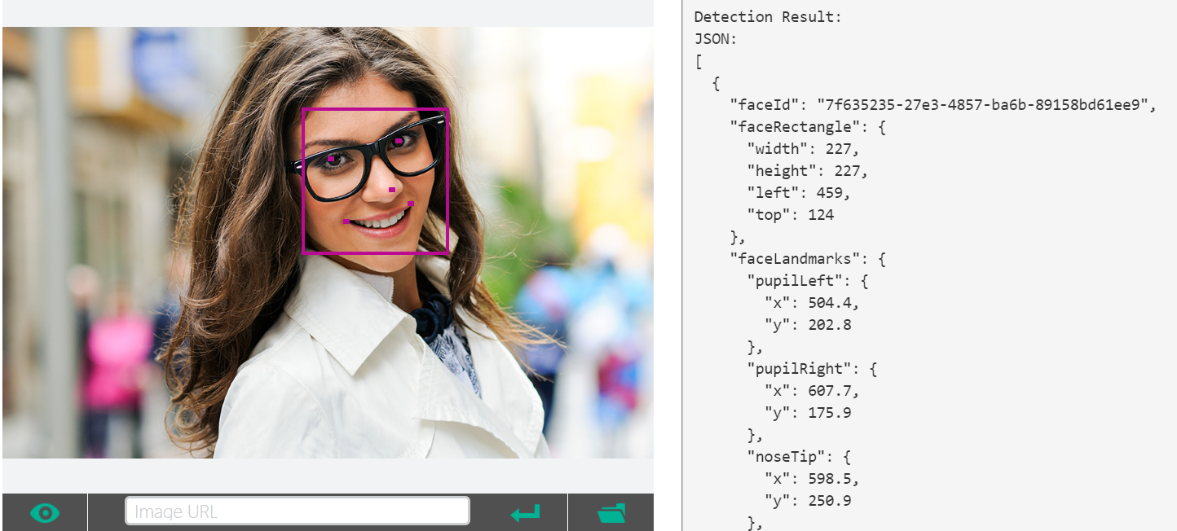
Face Detect
Notes:
Face Detection
Detect one or more human faces in an image and get back face rectangles for where in the image the faces are, along with face attributes which contain machine learning-based predictions of facial features.
After detecting faces, you can take the face rectangle and pass it to the Emotion API to speed up processing.
The face attribute features available are: Age, Gender, Pose, Smile, and Facial Hair along with 27 landmarks for each face in the image.
Face Detect
Optional parameters for returning faceId, landmarks, and attributes. Attributes include age, gender, smile intensity, facial hair, head pose and glasses. faceId is for other APIs use includingFace - Identify, Face - Verify, and Face - Find Similar.
JPEG, PNG, GIF(the first frame), and BMP are supported. The image file size should be larger than or equal to 1KB but no larger than 4MB.
The detectable face size is between 36x36 to 4096x4096 pixels. The faces out of this range will not be detected.
A maximum of 64 faces could be returned for an image. The returned faces are ranked by face rectangle size in descending order.
Some faces may not be detected for technical challenges, e.g. very large face angles (head-pose) or large occlusion. Frontal and near-frontal faces have the best results.
Attributes (age, gender, headPose, smile, facialHair, glasses and emotion) are still experimental and may not be very accurate. HeadPose's pitch value is a reserved field and will always return 0.
faceId
Unique faceId of the detected face, created by detection API and it will expire in 24 hours after detection call. To return this, it requires "returnFaceId" parameter to be true.
faceRectangle
A rectangle area for the face location on image.
faceLandmarks
An array of 27-point face landmarks pointing to the important positions of face components. To return this, it requires "returnFaceLandmarks" parameter to be true.
faceAttributes
Face Attributes:age: an age number in years.
gender: male or female.
smile: smile intensity, a number between [0,1]
facialHair: consists of lengths of three facial hair areas: moustache, beard and sideburns.
headPose: 3-D roll/yew/pitch angles for face direction. Pitch value is a reserved field and will always return 0.
glasses: glasses type. Possible values are 'noGlasses', 'readingGlasses', 'sunglasses', 'swimmingGoggles'.
emotion: emotions intensity expressed by the face, incluing anger, contempt, disgust, fear, happiness, neutral, sadness and surprise.
"faceId": "7f635235-27e3-4857-ba6b-89158bd61ee9",
"faceRectangle"
"faceLandmarks" 28
"pupilLeft" "pupilRight" "noseTip" "mouthLeft" "mouthRight" "eyebrowLeftOuter" "eyebrowLeftInner" "eyeLeftOuter" "eyeLeftTop" "eyeLeftBottom" "eyeLeftInner"
"eyebrowRightInner" "eyebrowRightOuter" "eyeRightInner" "eyeRightTop"
"eyeRightBottom" "eyeRightOuter" "noseRootLeft" "noseRootRight"
"noseLeftAlarTop" "noseRightAlarTop" "noseLeftAlarOutTip" "noseRightAlarOutTip"
"upperLipTop" "upperLipBottom" "underLipTop": "underLipBottom" }
"faceAttributes"
"age": 23.8,
"gender": "female",
"headPose"
"roll": -16.9,
"yaw": 21.3,
"pitch": 0
"smile": 0.826,
"facialHair"
"moustache": 0,
"beard": 0,
"sideburns": 0
"glasses": "ReadingGlasses",
"emotion"
"anger": 0.103,
"contempt": 0.003,
"disgust": 0.038,
"fear": 0.003,
"happiness": 0.826,
"neutral": 0.006,
"sadness": 0.001,
"surprise": 0.02

Slide 6
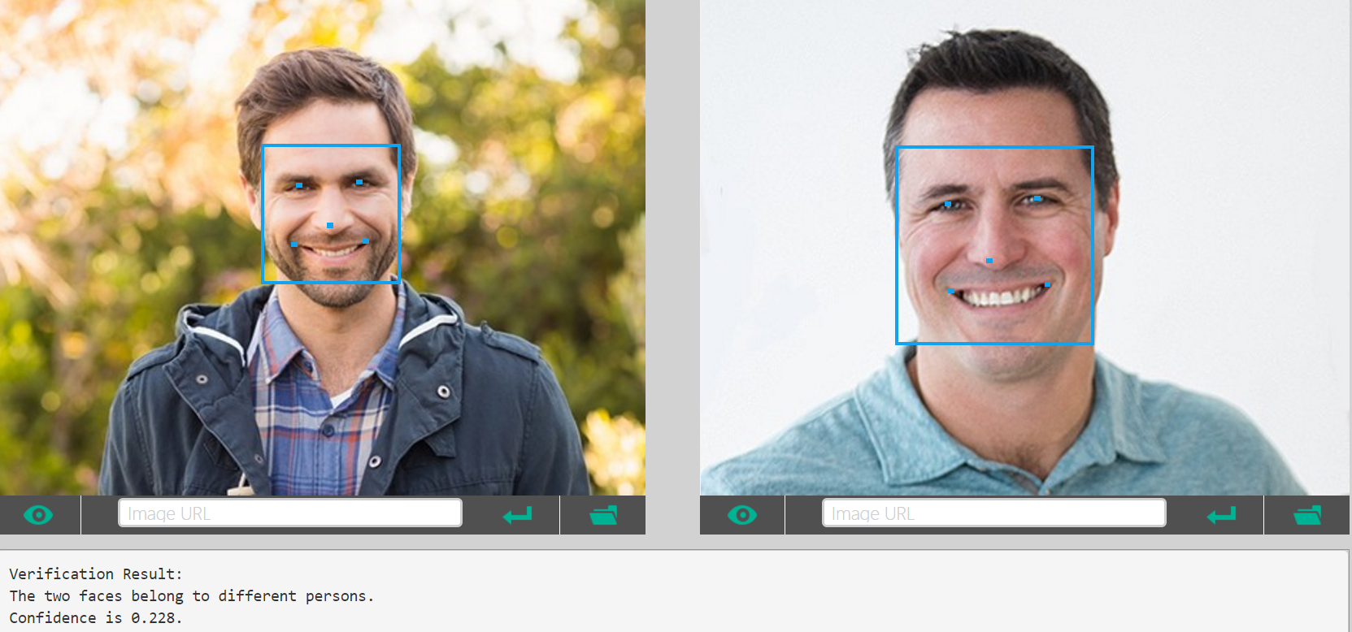
Face Verify
Notes:
Face Verify
Check the likelihood that two faces belong to the same person. The API will return a confidence score about how likely it is that the two faces belong to one person.
This API works well for frontal and near-frontal faces.
For the scenarios that are sensitive to accuracy please make your own judgment.
JSON fields in face to face verification request body:
JSON fields in face to person verification request body:
isIdenticalBooleanTrue if the two faces belong to the same person or the face belongs to the person, otherwise false.confidenceNumberA number indicates the similarity confidence of whether two faces belong to the same person, or whether the face belongs to the person. By default, isIdentical is set to True if similarity confidence is greater than or equal to 0.5. This is useful for advanced users to override "isIdentical" and fine-tune the result on their own data.

Slide 7

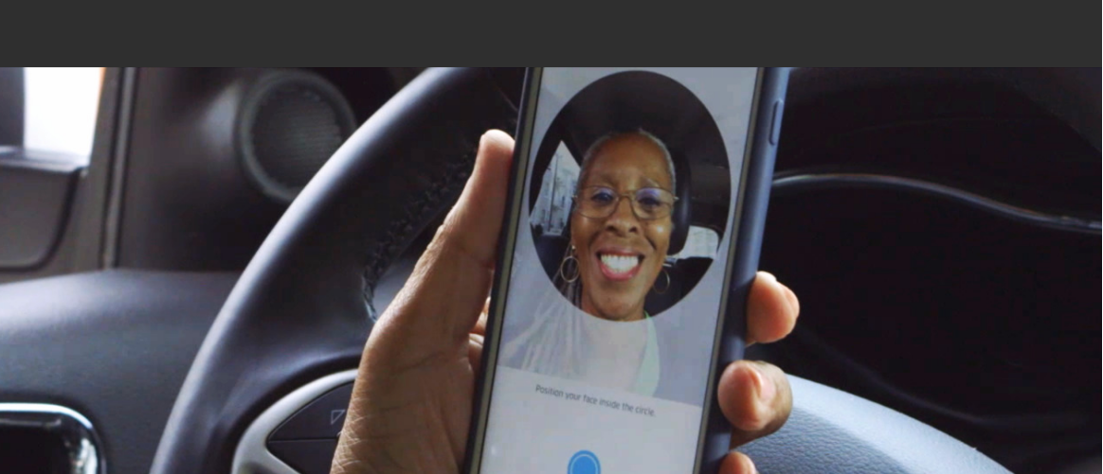
Case Study
“Thousands of partners sign in to our platform every hour. The response time from the Face API is incredible, enabling us to verify our drivers without slowing them down.”
Uber Product Manager
Dima Kovalev
Vision API
Notes:
Uber is using MSFT vision api to detect driver’s face.
In order to authenticate, they use the face detect, verify api to verify the driver who is already registered.
This authentication happens whenever the driver start the driving per day.

Slide 8
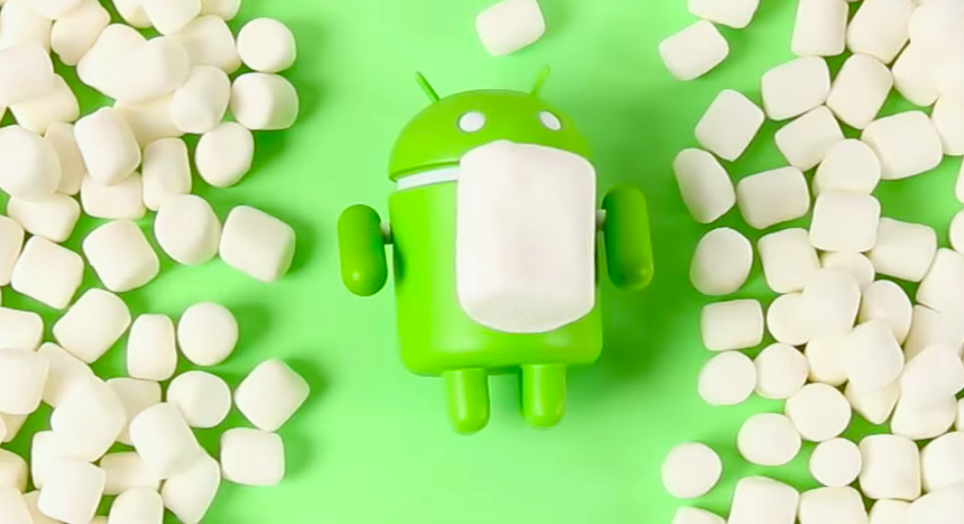

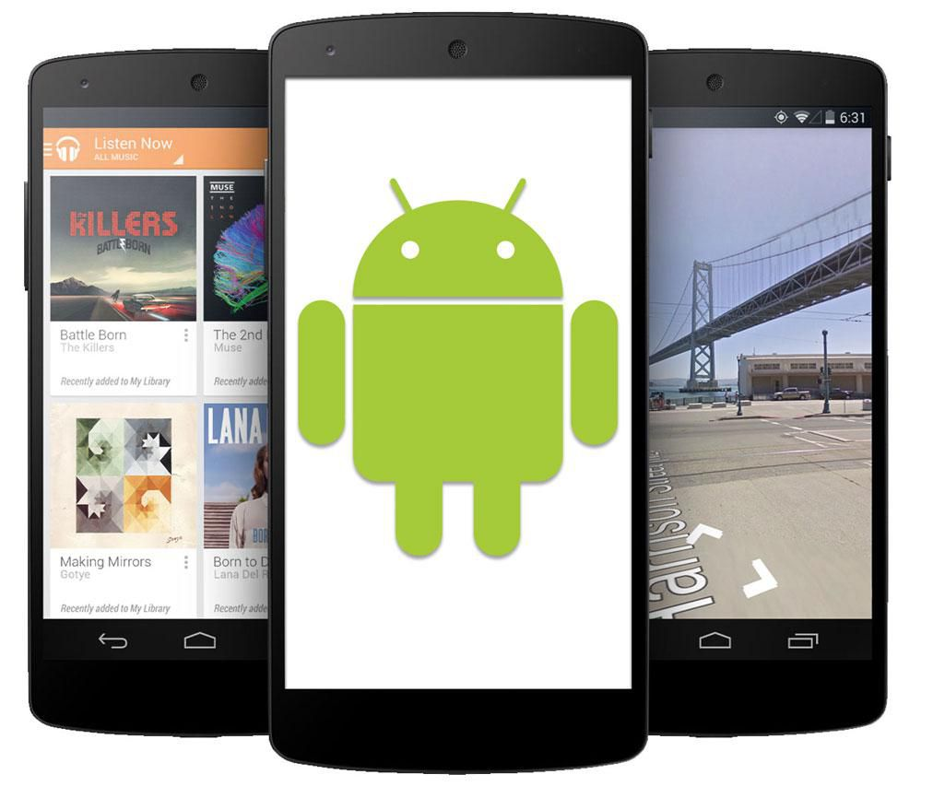

Facial Login App Environment
Android Emulator: Genymotion2.11.0, Virtual Box v5.2.0
Android Studio: 3.0
Android Phone: Asus Z016D
SDK: Android 6.0.1 API23 (Marshmallow)

Slide 9



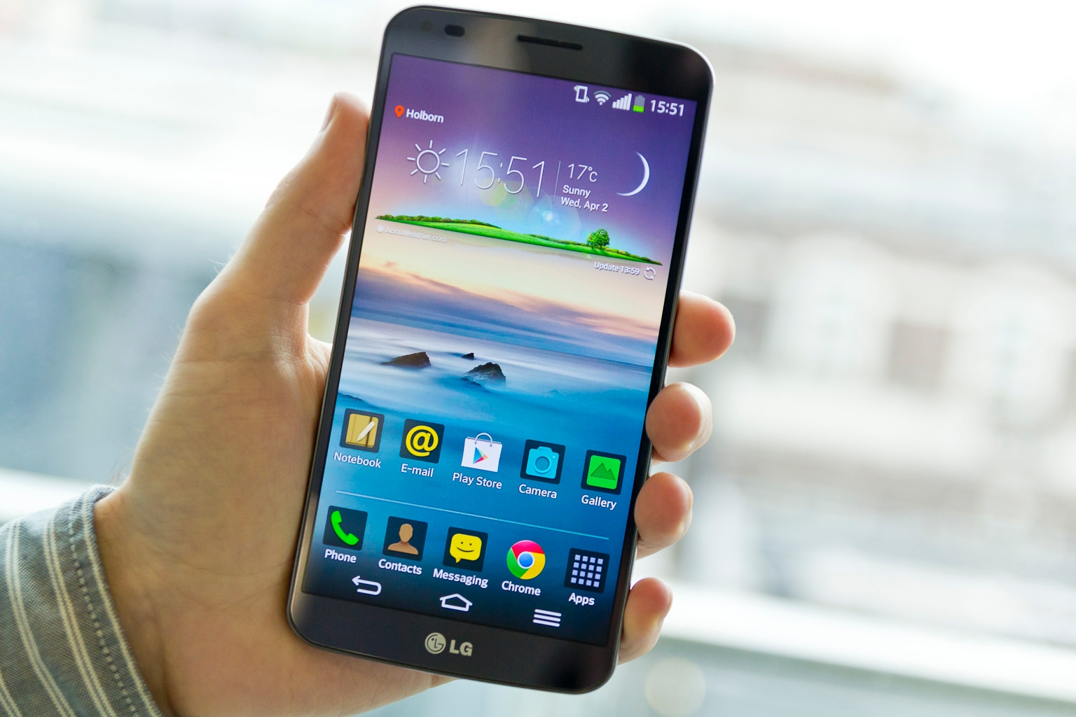

Facial Login App User Scenario
Face Detection
1
2
Facial Login
for Any App
Authentication by using
Microsoft Azure
Vision API
3
Notes:
User scenario
User may register him/her face data into their smartphone
Any app on the smartphone can use the Facial Login System
Facial Login System will authenticate by using Microsoft Azure Vision API
Microsoft Vision API
- Face Detect
: We will use this feature in order to register the user’s face and when they authenticate. More details are below.
Optional parameters for returning faceId, landmarks, and attributes. Attributes include age, gender, smile intensity, facial hair, head pose and glasses. faceId is for other APIs use including Face - Identify, Face - Verify, and Face - Find Similar.
JPEG, PNG, GIF(the first frame), and BMP are supported. The image file size should be larger than or equal to 1KB but no larger than 4MB.
The detectable face size is between 36x36 to 4096x4096 pixels. The faces out of this range will not be detected.
A maximum of 64 faces could be returned for an image. The returned faces are ranked by face rectangle size in descending order.
Some faces may not be detected for technical challenges, e.g. very large face angles (head-pose) or large occlusion. Frontal and near-frontal faces have the best results.
Attributes (age, gender, headPose, smile, facialHair, glasses and emotion) are still experimental and may not be very accurate. HeadPose's pitch value is a reserved field and will always return 0.
faceId
Unique faceId of the detected face, created by detection API and it will expire in 24 hours after detection call. To return this, it requires "returnFaceId" parameter to be true.
faceRectangle
A rectangle area for the face location on image.
faceLandmarks
An array of 27-point face landmarks pointing to the important positions of face components. To return this, it requires "returnFaceLandmarks" parameter to be true.
faceAttributes
Face Attributes:age: an age number in years.
gender: male or female.
smile: smile intensity, a number between [0,1]
facialHair: consists of lengths of three facial hair areas: moustache, beard and sideburns.
headPose: 3-D roll/yew/pitch angles for face direction. Pitch value is a reserved field and will always return 0.
glasses: glasses type. Possible values are 'noGlasses', 'readingGlasses', 'sunglasses', 'swimmingGoggles'.
emotion: emotions intensity expressed by the face, incluing anger, contempt, disgust, fear, happiness, neutral, sadness and surprise.
"faceId": "7f635235-27e3-4857-ba6b-89158bd61ee9",
"faceRectangle"
"faceLandmarks" 28
"pupilLeft" "pupilRight" "noseTip" "mouthLeft" "mouthRight" "eyebrowLeftOuter" "eyebrowLeftInner" "eyeLeftOuter" "eyeLeftTop" "eyeLeftBottom" "eyeLeftInner"
"eyebrowRightInner" "eyebrowRightOuter" "eyeRightInner" "eyeRightTop"
"eyeRightBottom" "eyeRightOuter" "noseRootLeft" "noseRootRight"
"noseLeftAlarTop" "noseRightAlarTop" "noseLeftAlarOutTip" "noseRightAlarOutTip"
"upperLipTop" "upperLipBottom" "underLipTop": "underLipBottom" }
"faceAttributes"
"age": 23.8,
"gender": "female",
"headPose"
"roll": -16.9,
"yaw": 21.3,
"pitch": 0
"smile": 0.826,
"facialHair"
"moustache": 0,
"beard": 0,
"sideburns": 0
"glasses": "ReadingGlasses",
"emotion"
"anger": 0.103,
"contempt": 0.003,
"disgust": 0.038,
"fear": 0.003,
"happiness": 0.826,
"neutral": 0.006,
"sadness": 0.001,
"surprise": 0.02
- Face Verify
: We will use this feature in order to authenticate the user’s current face and stored face image. More details are below.
This API works well for frontal and near-frontal faces.
For the scenarios that are sensitive to accuracy please make your own judgment.
JSON fields in face to face verification request body:
JSON fields in face to person verification request body:
isIdenticalBooleanTrue if the two faces belong to the same person or the face belongs to the person, otherwise false.confidenceNumberA number indicates the similarity confidence of whether two faces belong to the same person, or whether the face belongs to the person. By default, isIdentical is set to True if similarity confidence is greater than or equal to 0.5. This is useful for advanced users to override "isIdentical" and fine-tune the result on their own data.
The face attribute features available are: Age, Gender, Pose, Smile, and Facial Hair along with 27 landmarks for each face in the image.

Slide 10
Facial Login App – Component Diagram
Facial Login App sends taken photo message (M0) to Face Login Index Cell. The Face Login Index Cell sends detect message (M01) to Face Detect Index Cell, and it will send the detect result message (M02) to MSFT Azure Cognitive Index Cell. Once MSFT Azure Cognitive Index Cell processes the face detect, it will send the result message to Face Detect Index Cell, then Face Detect Index Cell will send the result to Face Login Index Cell. For the face verify process, it is same as face detect flow other than its input is the face ID which is a result from face detect.
M0
Face Login Index Cell
M01
Face Detect Index Cell
M04
M02
M03
M05
M08
Face Verity Index Cell
M06
MSFT Azure Cognitive Index Cell
M07

Slide 11
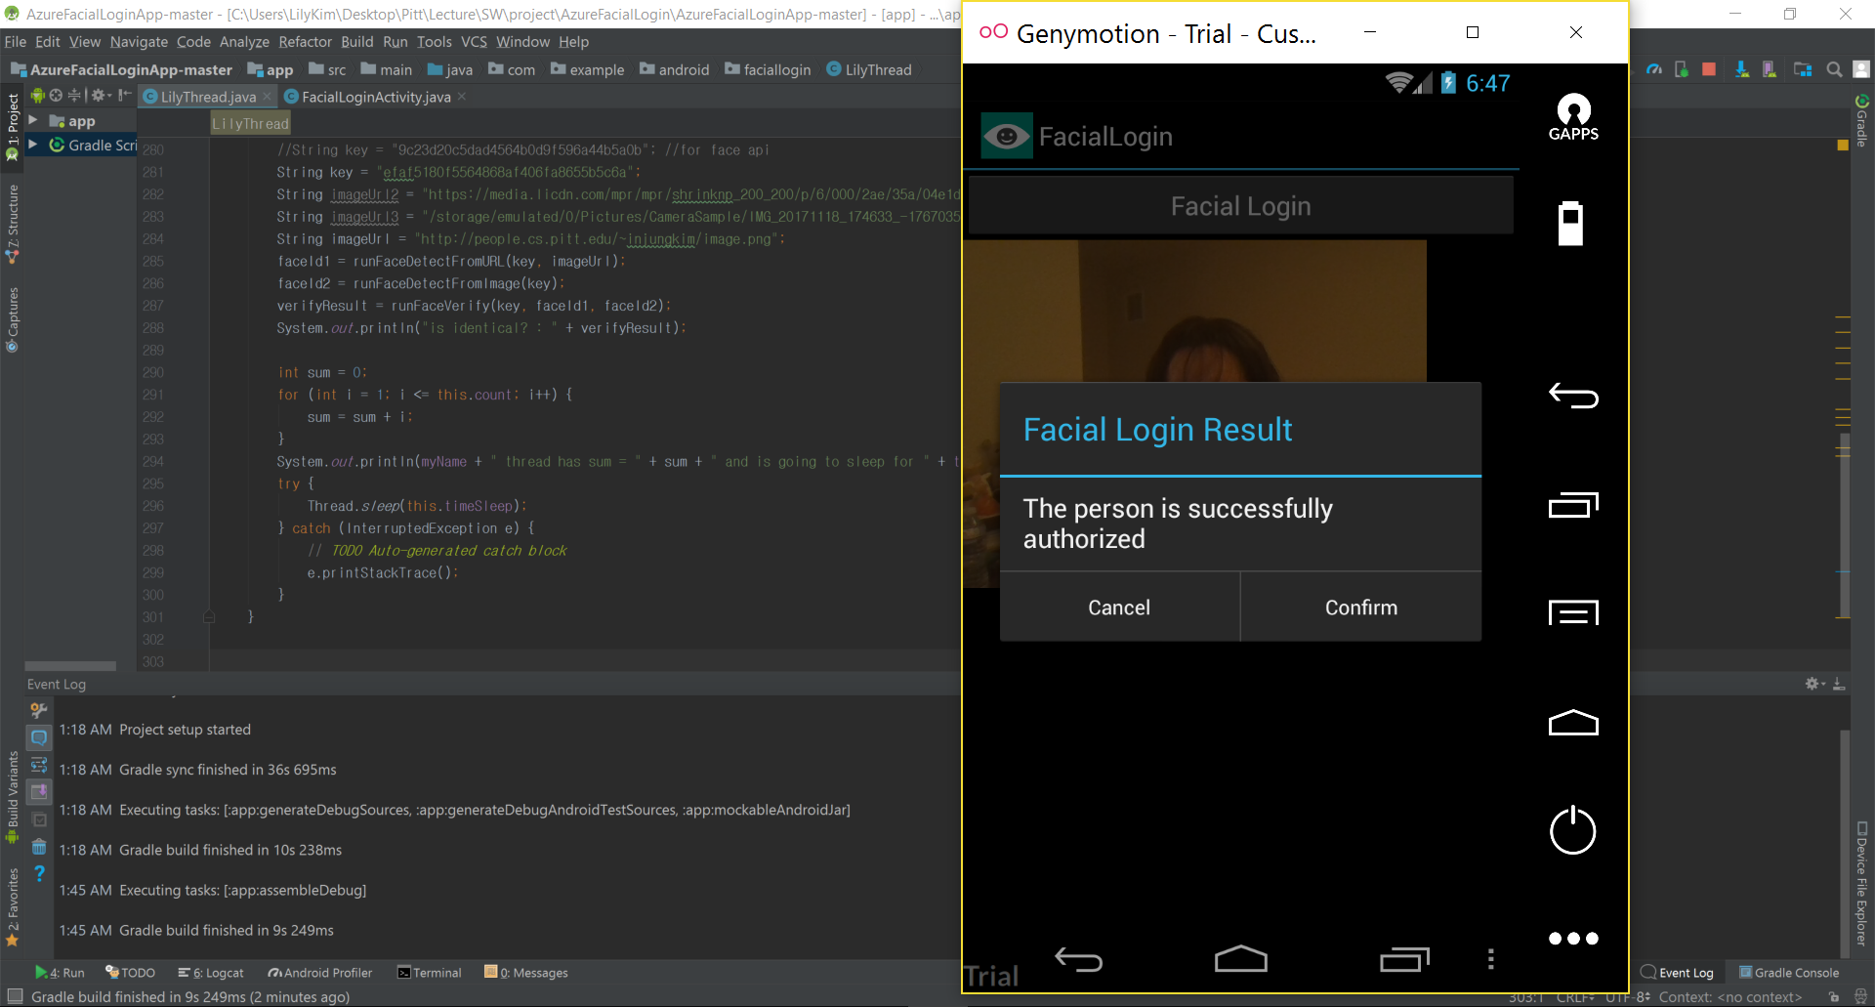
Facial Login App Demo - Success
Notes:
This is the facial login successful result page and the code (background)

Slide 12
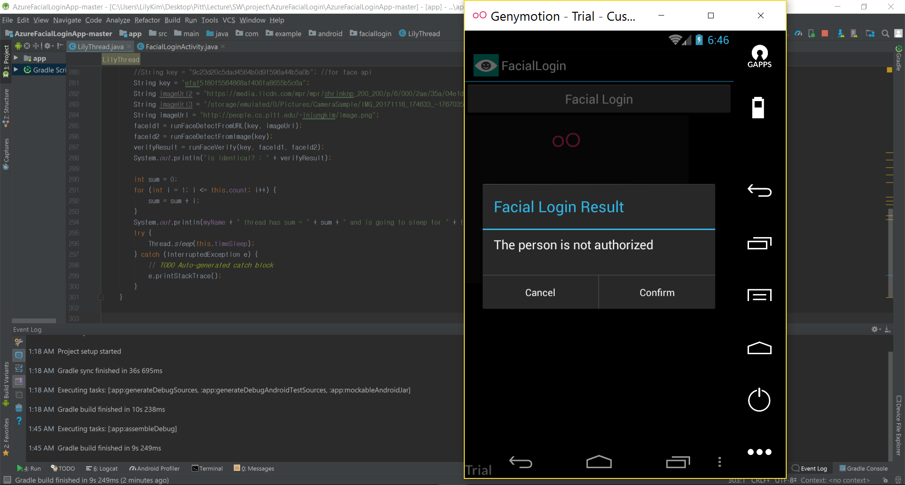
Facial Login App Demo - Fail
Notes:
This is the facial login fail result page and the code (background)

Slide 13
Demo

Slide 14
Emotion Detection

Slide 15
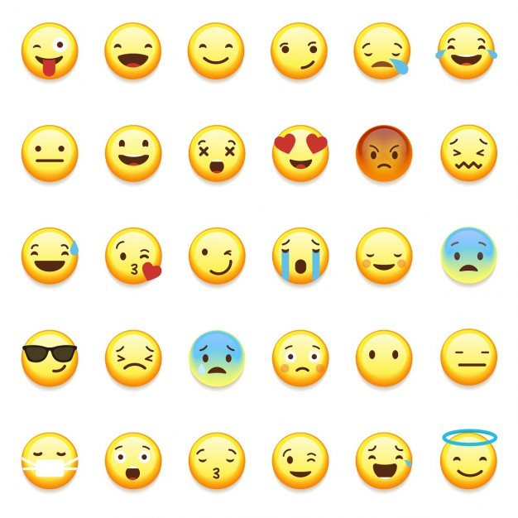
Emotion Detection?
The Emotion API takes a facial expression in an image as an input
returns the confidence across a set of emotions
The emotions detected are
anger, contempt, disgust, fear, happiness, neutral, sadness, surprise.
These emotions are understood to be cross-culturally and universally communicated with particular facial expressions.

Slide 16
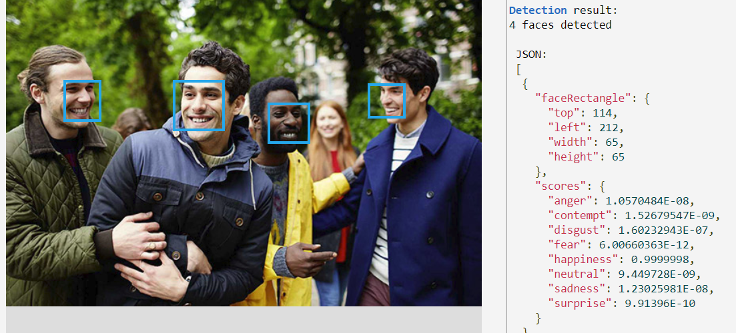
Notes:
They return the scores of emotions and it expressed by exponent scientific notation.
For example, 1.23E-11 is 1.23 x 10⁻¹¹, which very small number.
For this example photo, first detected person has happiness emotion at most.

Slide 17
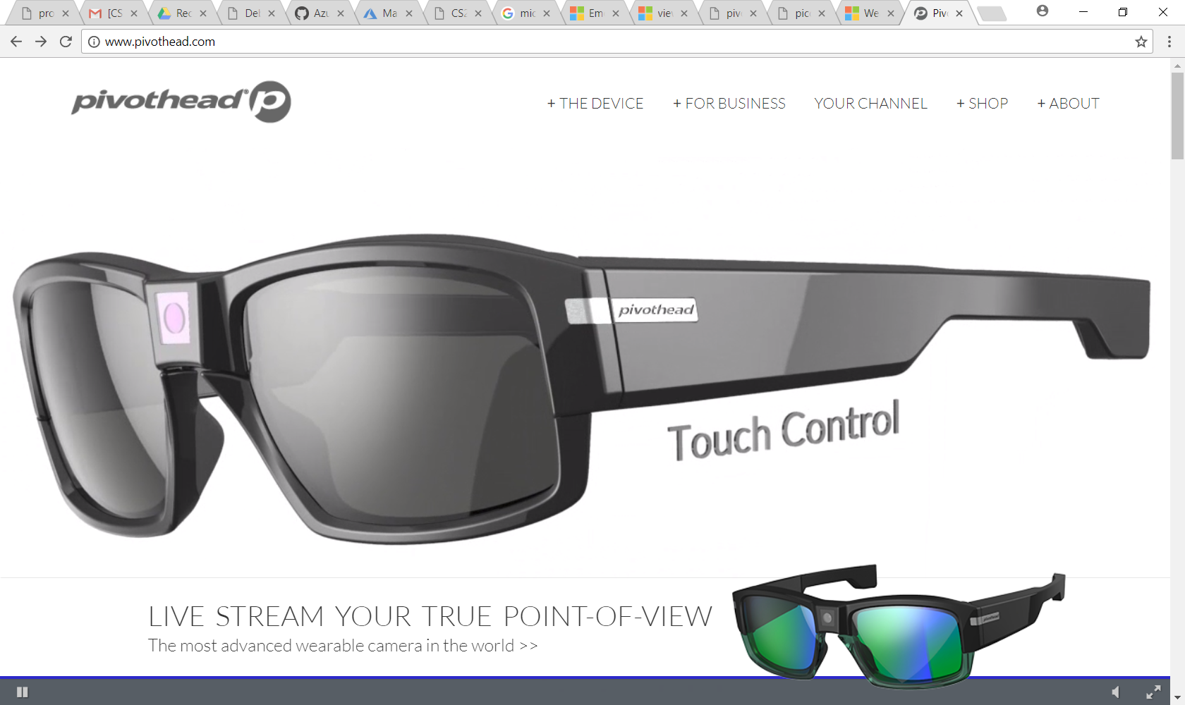
Case Study
"Using the Cognitive Services APIs, it took us three months to develop a test pair of glasses that can translate text & images into speech, identify emotions, and describe scenery. "
Benoit Chirouter: R&D Director
Pivothead
Emotion API
Notes:
Using Microsoft Cognitive Services APIs,
Pivothead is working on a project for people with impaired vision,
which incorporates software that translates images and text to speech, and provides detailed descriptions that help them see the world in front of them.

Slide 18

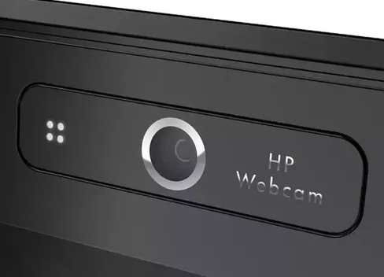


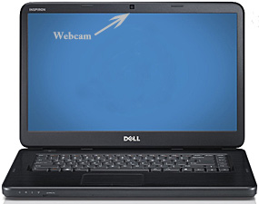
Emotion Detect User Scenario
Face Detection
(from Camera/URL)
Implemented in
Pycharm with Python 2.7
1
Extract Emotion Result by using
Microsoft Azure
Emotion API
2
Notes:
Detect Emotion
Detect face from the image, then guess emotion and other info
Face API would detect face from the image
Emotion API would get emotion information
score Anger, Contempt, Disgust, Fear, Happiness, Neutral, Sadness, Surprise
anger, contempt, disgust, fear, happiness, neutral, sadness, and surprise

Slide 19
Emotion Detection – Component Diagram
Emotion Detection sends taken photo or URL message (M0) to Emotion Detection Index Cell. Emotion Detection Index Cell sends detect message (M01) to Face Detect Index Cell, and it will send the detect result message (M02) to MSFT Azure Cognitive Index Cell. Once MSFT Azure Cognitive Index Cell processes the face detect, it will send the result message to Face Detect Index Cell, then Face Detect Index Cell will send the result to Emotion Detection Index Cell. For the Emotion Recognize process, it is same as face detect flow other than its input is the face ID which is a result from face detect.
M0
Emotion Detection Index Cell
M01
Face Detect Index Cell
M04
M02
M03
M05
M08
Emotion Recognize Index Cell
M06
MSFT Azure Cognitive Index Cell
M07

Slide 20
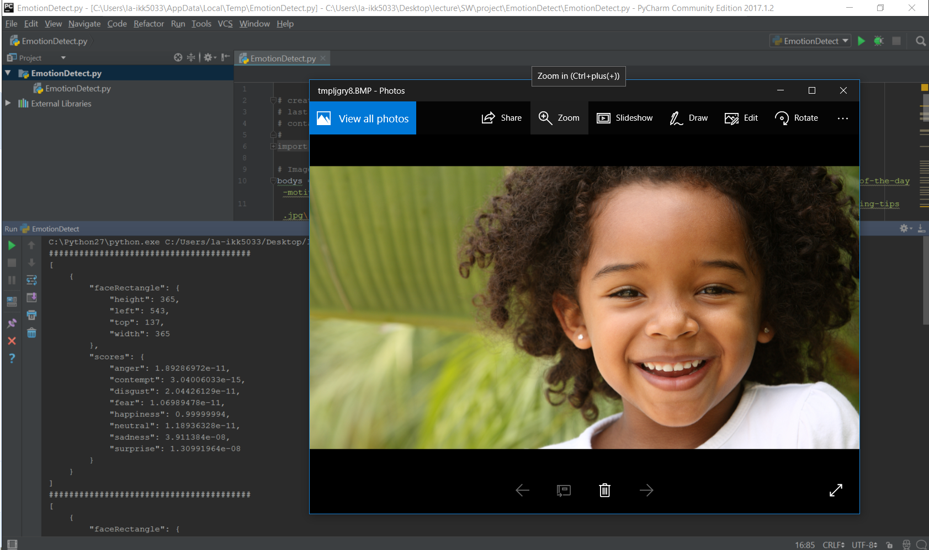
Emotion Detect Demo
“happiness":
0.99999994
Notes:
This is the example of detect emotion from an image and wrote the highest score value which is happiness

Slide 21
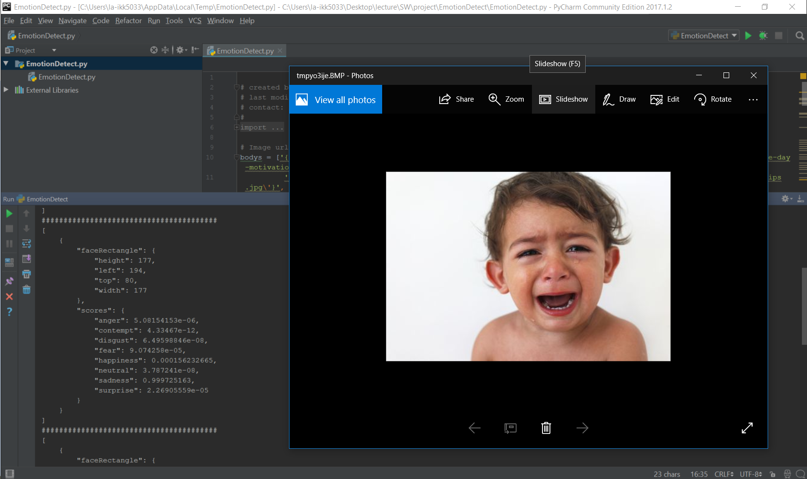
Emotion Detect Demo
"sadness":
0.999725163,

Slide 22
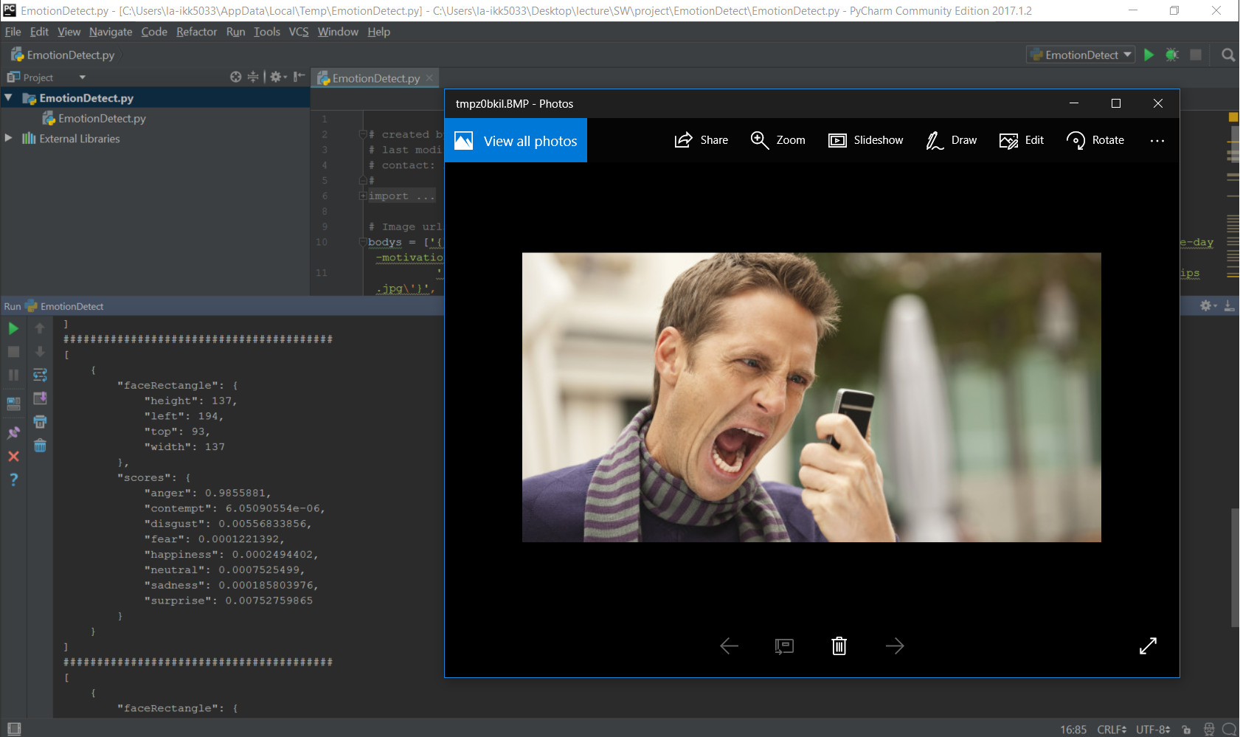
Emotion Detect Demo
"anger":
0.9855881,

Slide 23
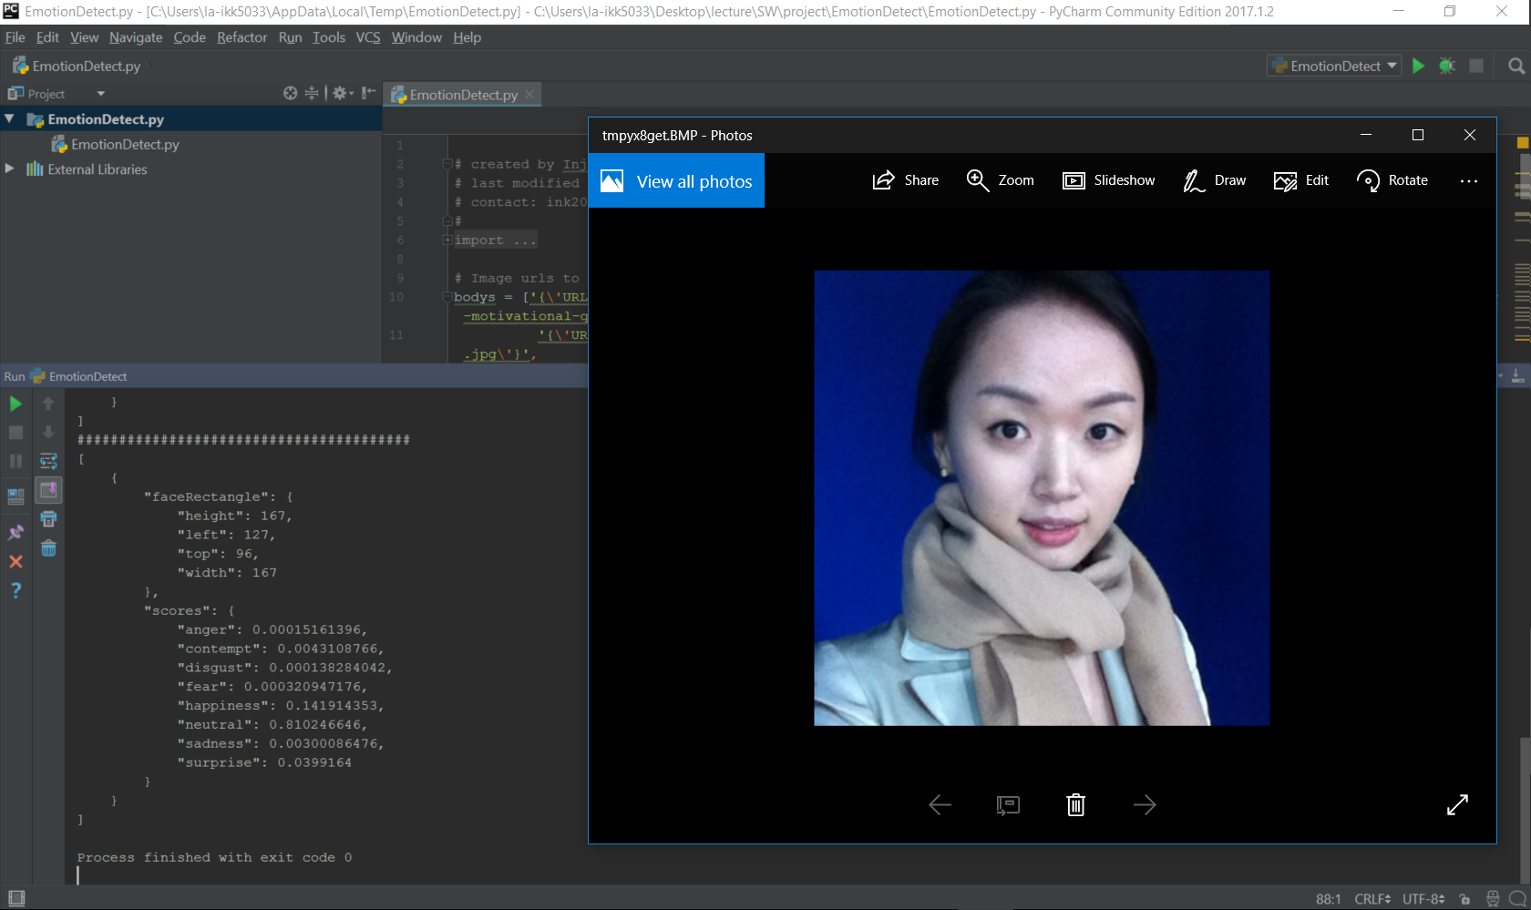
Emotion Detect Demo
"neutral":
0.810246646,
Notes:
As we may know, lots of Asian people don’t have many facial express. (I guess this is why we have less wrinkle)
From my Linkedin profile photo, we can see the highest value is “Neutral”

Slide 24
Demo

Slide 25

Conclusion
Facial Login / Emotion Detect
Component Flexibility
Component Usability
Next-Generation of
Biometric Login System
Can computer detect
people’s emotion?
Integrate using the language
and platform of any choice
Breadth of offerings to find the
right API for us
Code Reuse
Roll your own with REST APIs
Simple: just a few lines of code
Built by experts from MSFT
Research, Other gurus
Quality documentation,
sample code, and community
Notes:
For the code reuse, as I presented in the paper seminar, we can think about software reuse or code reuse.
When we think the Microsoft Azure API as a component, we can use this to build any app or program.
Here as I shown two different demo on the top of different platforms with different language, I can say it was just a few lines of code.
For the emotion detection program, lines of code (loc) was about 50, and facial login app was 700 loc.
So we can say using their API was only about 50 lines and rest of 650 lines are for building smartphone app.
There are also diverse resource such as github, stackoverflow, msdn and so on.
Thank you for listening.

Slide 26
Documentation [1] https://docs.microsoft.com/en-us/azure/cognitive-services/ [2] https://azure.microsoft.com/en-us/services/active-directory/ Client SDKs [1] https://github.com/Microsoft/ProjectOxford-ClientSDK [2] https://github.com/felixrieseberg/project-oxford (nodejs) [3] https://github.com/southwood/project-oxford-python [4] https://github.com/microsoftgraph/android-java-connect-rest-sample Example Code [1] https://github.com/jsturtevant/happy-image-tester-django [2] https://github.com/jsturtevant/happy-mage-tester-nodejs Paper & Article [1] Mobile/Tablet Operating System Market Share https://www.netmarketshare.com/operating-system-market-share.aspx?qprid=8&qpcustomd=1&qpct=3 [2] Native development vs cross-platform development: myth and reality https://www.mobindustry.net/native-development-vs-cross-platform-development-myth-and-reality/ [3] Stack overflow trends https://stackoverflow.blog/2017/05/16/exploring-state-mobile-development-stack-overflow-trends/ [4] S. Xanthopoulos, S. Xinogalos “A Comparative Analysis of Cross-platform Development Approaches for Mobile Applications” [5] IBM (Worklight Inc.) “Native, Web, or Hybrid Mobile Apps?” https://www.youtube.com/watch?v=Ns-JS4amlTc
References

